Slide 1
Data 621 Final Project: Predicting Fertility Rates
Authors: Vikas Sinha
Luisa Velasco
Dan Wigodsky
Sarah Wigodsky
Zhenni Xie

Slide 2
Introduction
Why is fertility rates projects important?
Total Fertility Rate (TFR)

Slide 3
Literature Review
A number of different future fertility rates projections are produced, corresponding with each underlying assumption.
Medium-fertility Assumption
High-fertility Assumption
Low-fertility Assumption
Constant-fertility Assumption
Instant-replacement Assumption

Slide 4
Literature Review
Modelling Fertility: A Semi-Parametric Approach
- Oberhofer and Reichsthaler, 2004
The author present a categorical model of fertility based on Generalized Linear Model.
Only one factor was used – the age of the mother
Bernoulli Random Variable
Local Likelihood Estimation

Slide 5
Data Source
UNData - A web-based data service for the global user community. It brings international statistical databases within easy reach of users through a single-entry point. Users can search and download a variety of statistical resources compiled by the United Nations (UN) statistical system and other international agencies.
Data Link: http://data.un.org/Explorer.aspx?d=WHO

Slide 6
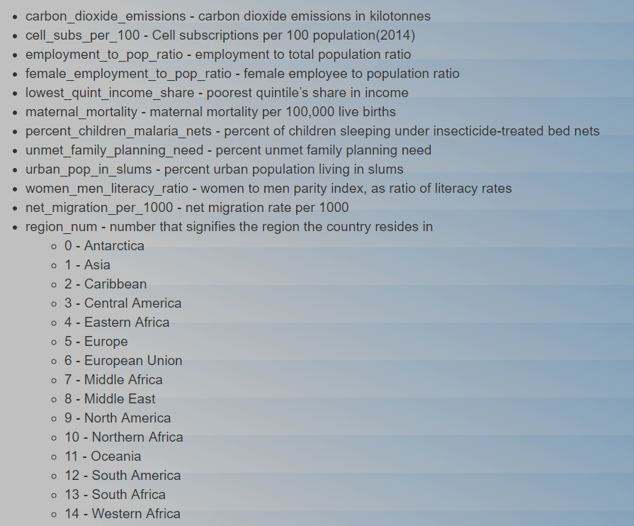
Data Exploration
The data set contains 214 rows, where each row represents from the data form a different country.
The following variables are used to build the model.

Slide 7
Challenge
How to handle the large number of missing values?
Percent of Children Sleeping Under Insecticide Treated Bed Nets
Carbon Dioxide Emissions
Cell Subscriptions per 100 Population
Employment to Population Ratio
Female Employment to Population Ratio
Lowest Quintile Income Share
Maternal Mortality
Unmet Family Planning Need
Percentage of Urban Population Living In Slums
The Literacy Ratio of Women to Men
Net Migration Per 1000

Slide 8
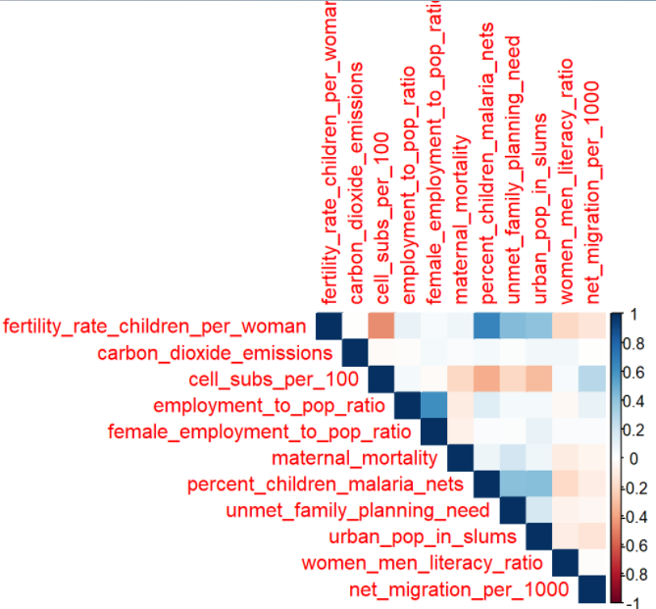
Data Correlation

Slide 9
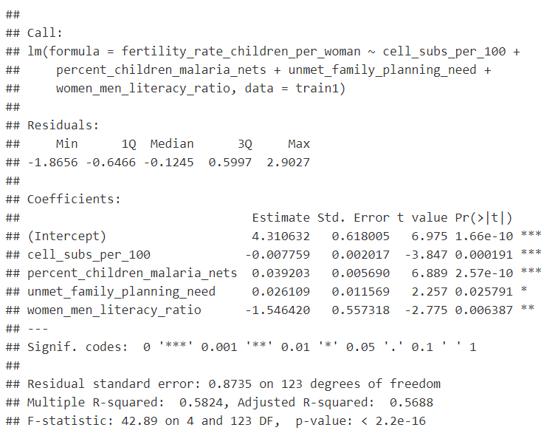
Build Models
Backward Elimination - Linear Regression Model - Model 1
Variables will be removed until every predictor has a p value below 0.05.
Prediction from Model 1
On average, the prediction for the fertility rate, is off by 1.15.

Slide 10
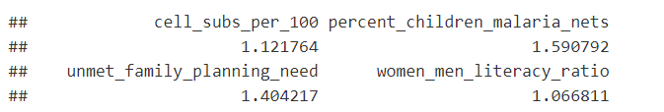
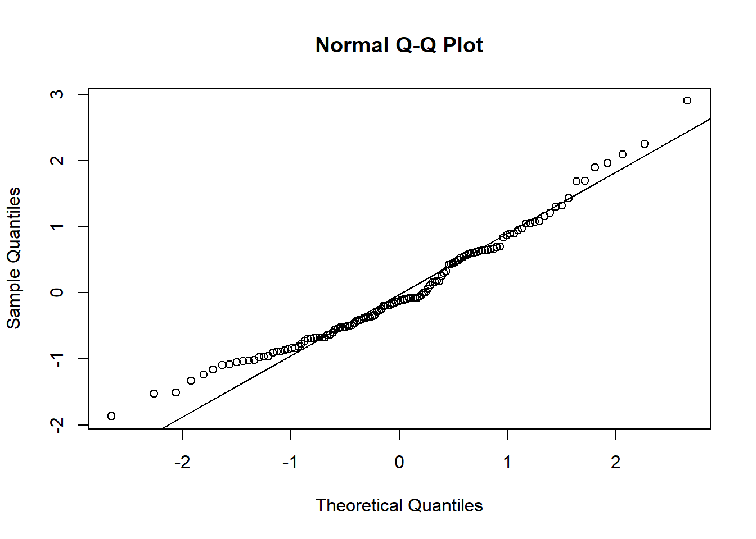
Model 1
Muliticolinearity Test
Q-Q Plot

Slide 11
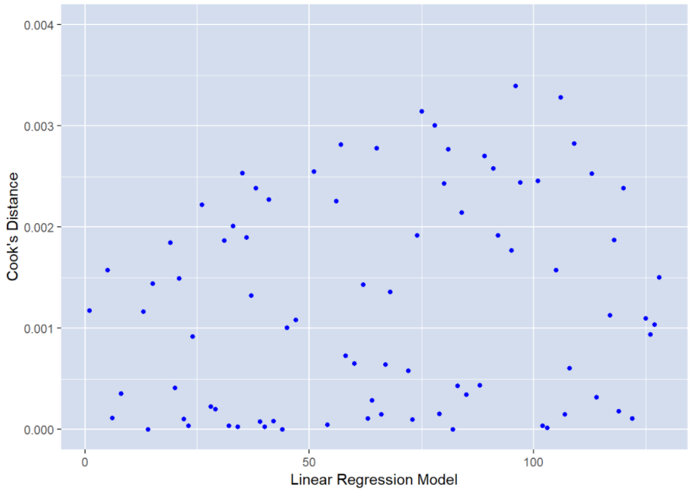
Model 1
Cook’s Distance

Slide 12

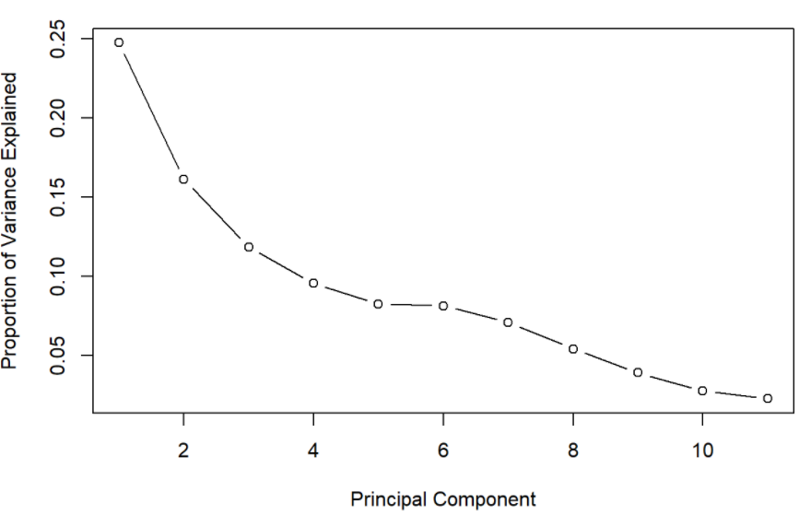
Model 2 - Principal Component Analysis
Root Mean Square Error
On average, a prediction of the fertility rate is off by 0.83.
Scree Plot

Slide 13
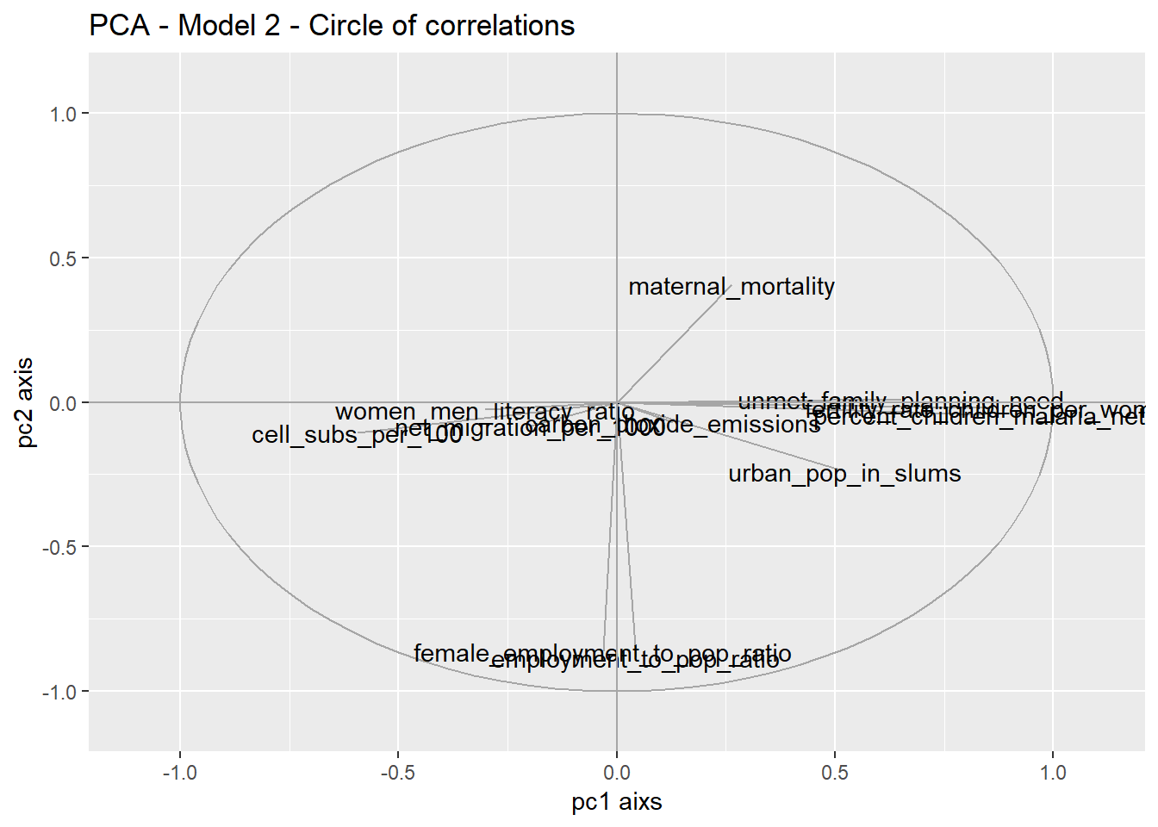
Model 2 - Principal Component Analysis

Slide 14

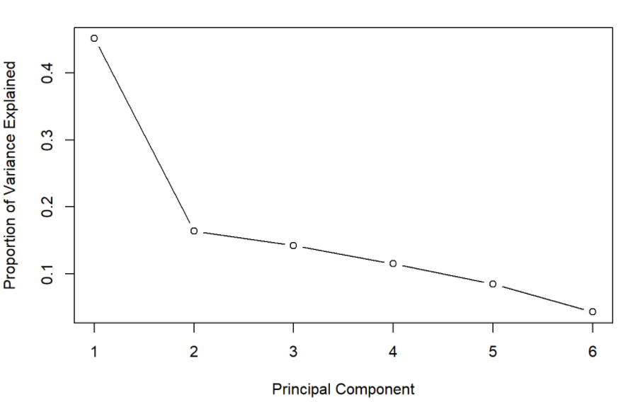
Model 3 - Principal Component Analysis (With only the variables correlated with fertility rate)
Root Mean Square Error
On average, a prediction of the fertility rate is off by 0.70.
Scree Plot

Slide 15
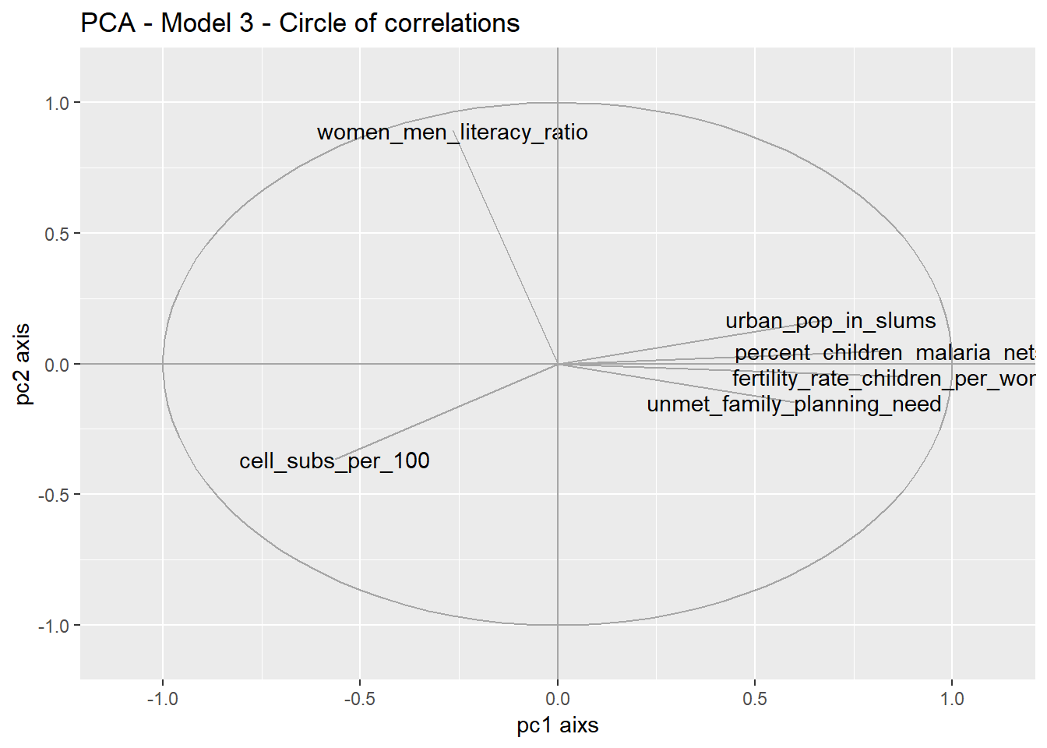
Model 3 - Principal Component Analysis (With only the variables correlated with fertility rate)

Slide 16
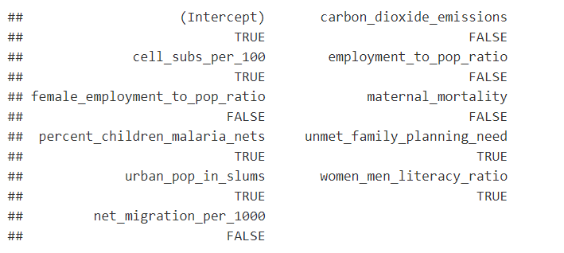
Model 4 - Regression Subset Selection
Number of variables with highest adjusted ( R^2 ). Variables marked with TRUE are the ones that will be chosen.

Slide 17
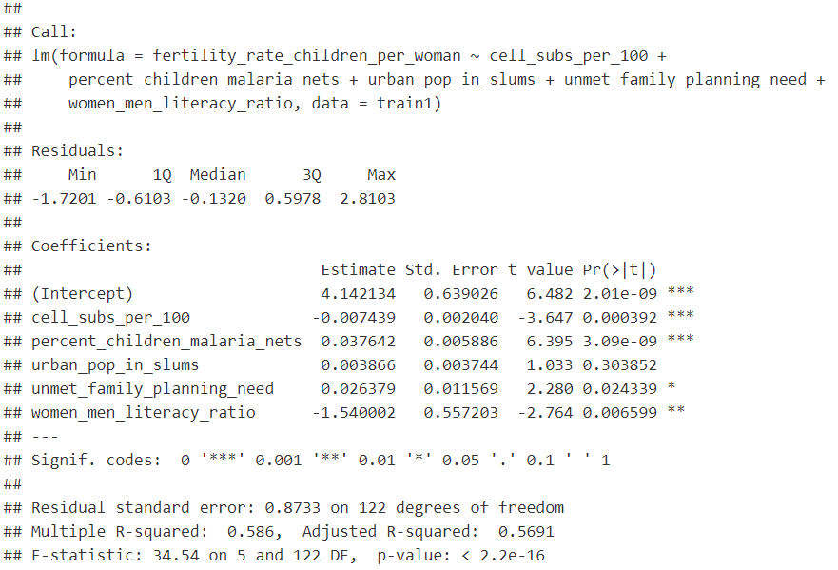
Model 4 - Regression Subset Selection

Slide 18

Model 4 - Regression Subset Selection
Prediction from Model 4
On average, the prediction for the fertility rate is off by 1.14.

Slide 19
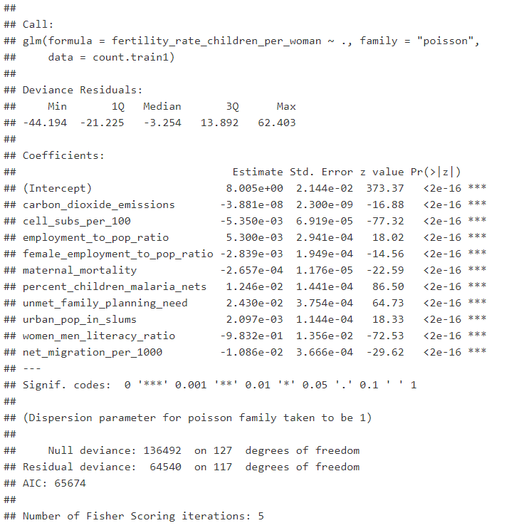
Model 5- Count Models (Poisson, Negative Binomial, Zero Inflated)

Slide 20
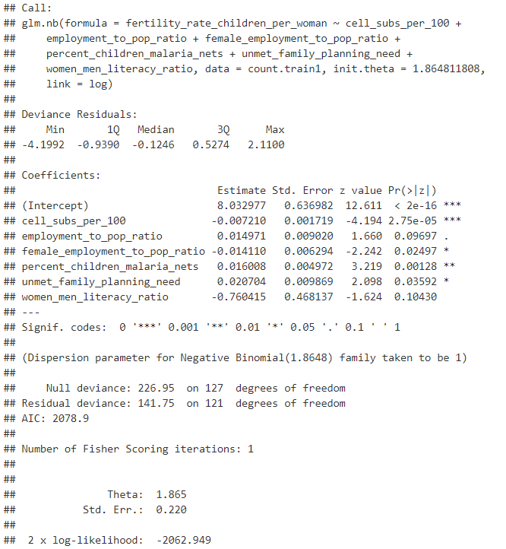
Model 5- Count Models (Poisson, Negative Binomial, Zero Inflated)

Slide 21
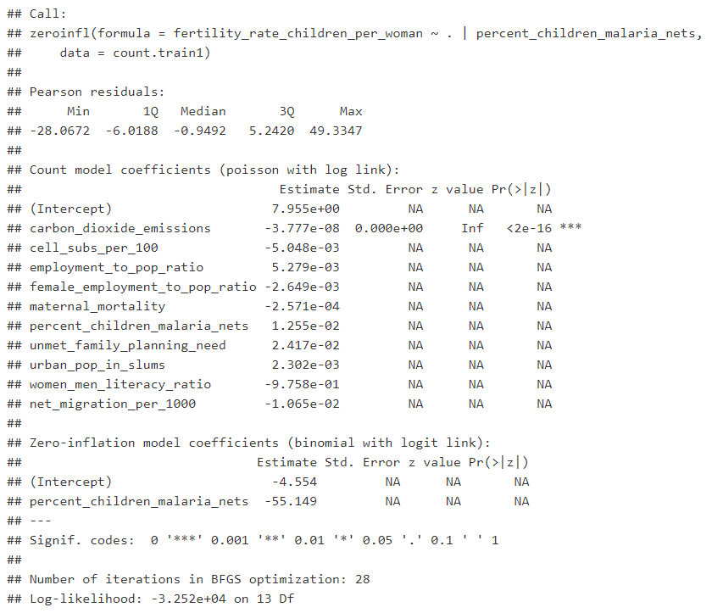
Model 5- Count Models (Poisson, Negative Binomial, Zero Inflated)

Slide 22
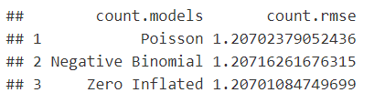
Model 5- Count Models (Poisson, Negative Binomial, Zero Inflated)
Prediction from Count Models
On average, the prediction for the fertility rate is off by 1.21.

Slide 23
Discussion and Conclusion
It is possible to predict the fertility rate in a country based on the percent of children sleeping under insecticide treated bed nets, the percentage of the urban population in slums, unmet family planning need, the number of cellular subscriptions and the ratio of the literacy rate between women and men.
Seven different models were created and gave relatively similar results, and the model with lowest root mean square error was model 3.
Higher fertility rates are associated with having more children sleeping under insecticide treated bed nets, higher percentages of the urban population living in slums and higher unmet family planning need.
From our analysis, it is not possible to ascertain whether a high fertility rate is the effect of these variables, the cause of these variables or simply correlated with them.
High fertility rates are associated with higher poverty levels and lower levels of education between women and men.

Slide 24
What to do next?
A source of further research would involve uncovering the nature of these connections to identify causation for fertility rates, not just correlations.

Slide 25
References
United Nations, Department of Economic and Social Affairs. World Population Prospects, The 2017 Revision. https://esa.un.org/unpd/wpp/Publications/Files/WPP2017_Methodology.pdf
Alkema et al (2011). Probabilistic Projections of the Total Fertility Rate for All Countries. https://www.ncbi.nlm.nih.gov/pmc/articles/PMC3367999/.
National Institute of Health (2011). NIH-funded study proposes new method to predict fertility rates. https://www.nih.gov/news-events/news-releases/nih-funded-study-proposes-new-method-predict-fertility-rates
United Nations, Department of Economic and Social Affairs. Population Trends. http://www.un.org/en/development/desa/population/theme/trends/index.shtml
Walter Oberhofer and Thomas Reichsthaler (2004). Modelling Fertility: A Semi-Parametric Approach.https://epub.uni-regensburg.de/4511/1/rdisb396.pdf

Slide 26
Appendix
Rpub Link: http://rpubs.com/sew/451479
Github Link: https://github.com/swigodsky/Data621/blob/master/finalProject_fertility.Rmd

